Slide 1




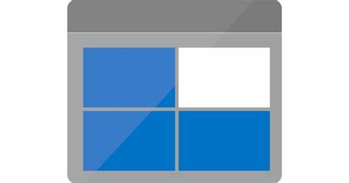



Source Systems
Data Lake
On - Prem
ADF
Pipelines
Containers
Daily push
A
Data Consumptions
Source1
Scheduled trigger
Daily push
B
Source2
Scheduled trigger
Source3
Daily push
C
Scheduled trigger
Source4
Daily push
D
Scheduled trigger

Slide 2
Prerequisites :
Resource group to have all the azure services
a self-hosted Integration Runtime
Linked Services for connecting to On Prem
Storage Accounts

